Slide 1
Contextual domain classification in spoken language understanding systems using recurrent neural network
IIS Lab.
Changyong Jeon
2016.07.15
IEEE International Conference on Acoustics, Speech and Signal Processing (ICASSP), 2014
Puyang Xu, Ruhi Sarikaya

Slide 2
Contents
Introduction
Proposed Methods
Experiments
Conclusion

Slide 3
Introduction
Spoken Language Understanding pipelines
Domain classification
Slot filling
Intent classification
In such pipelines, domain classification is the first step of the semantic analysis. While it is a standard classification task and seemingly less complex than other semantic analysis, the errors made by a domain classifier often lead to clearly wrong system responses such as invoking a wrong application

Slide 4
Introduction (cont.)
The multi-turn multi-domain classification problem in the context of a conversational session
T1: How is the weather in Houston (weather domain) T2: How about Orlando (weather domain) T3: Am I free tomorrow (calendar domain) T4: Find hours for Disney world (places domain) T5: Get driving directions (places domain)
The users tend to follow an intuitive and predictable thought process, resulting in exploitable patterns in the domain sequence.
Notes:
the user starts with two weather queries, then checks the calendar to make sure she has free time, and eventually asks the system to provide information about disney world, which is potentially her travel destination for tomorrow.

Slide 5
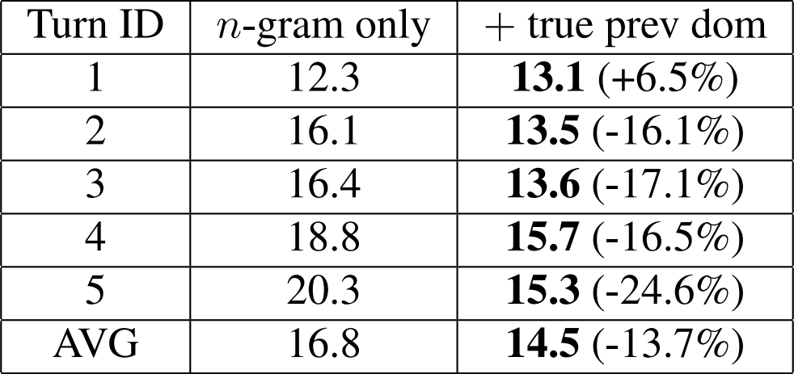
Introduction (cont.)
The benefit of context
The error rate using only non-contextual (n-gram) features increases monotonically as the conversation evolves, while the room for improvement provided by the previous domain label also grows monotonically.
Per-turn classification error rate (%) before and after adding the TRUE previous domain label as feature (SVM).

Slide 6
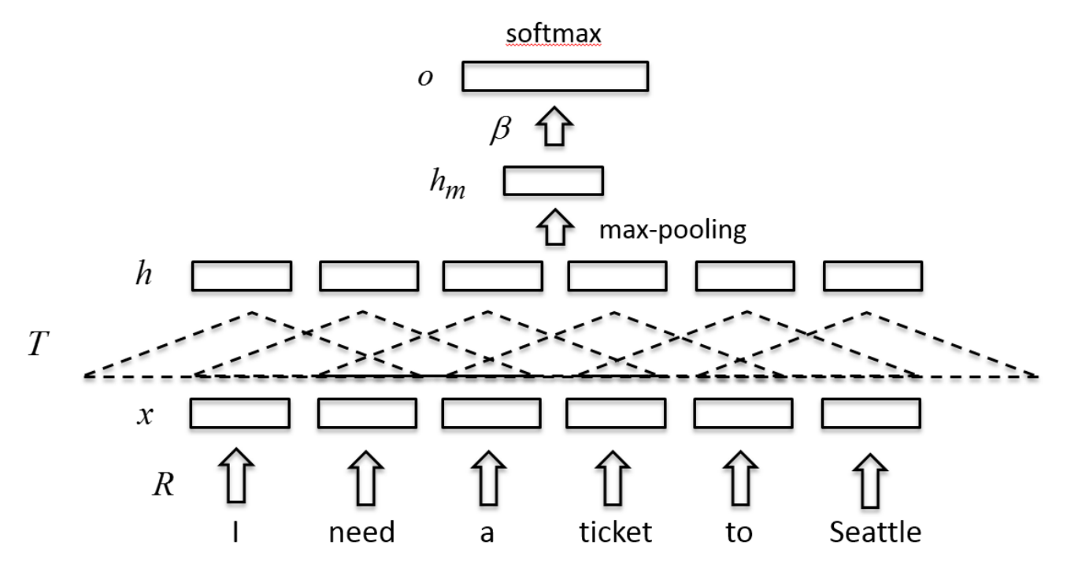
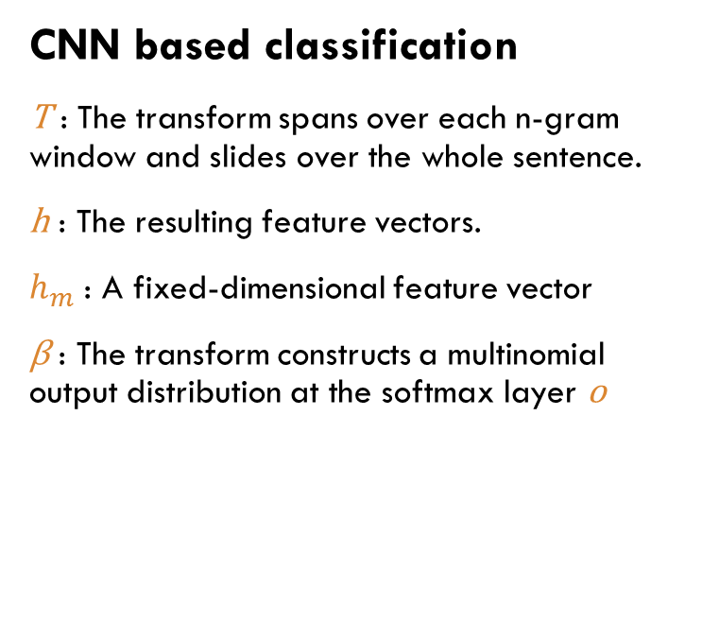
Proposed Methods
CNN based classification
T : The transform spans over each n-gram window and slides over the whole sentence.
h : The resulting feature vectors.
$h_{m}$ : A fixed-dimensional feature vector
β : The transform constructs a multinomial output distribution at the softmax layer o

Slide 7
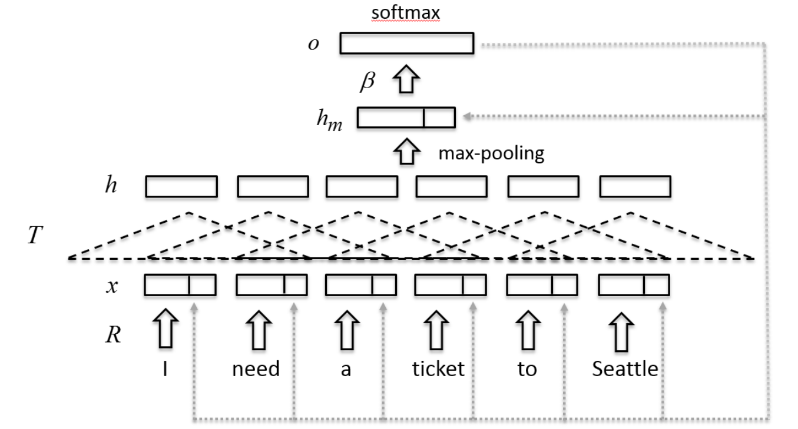
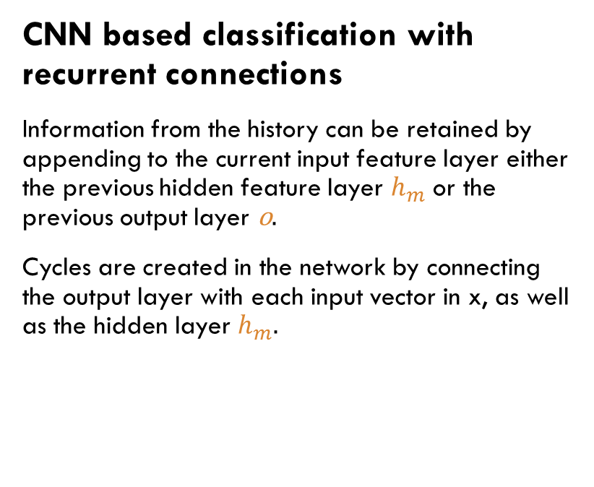
Proposed Methods (cont.)
CNN based classification with recurrent connections
Information from the history can be retained by appending to the current input feature layer either the previous hidden feature layer $h_{m}$ or the previous output layer o.
Cycles are created in the network by connecting the output layer with each input vector in x, as well as the hidden layer $h_{m}.$
Notes:
The training of the proposed model can follow the same procedure for training general RNN based models – back propagation can be carried out on the unfolded network, which is commonly known as the back propagation through time (BPTT).

Slide 8
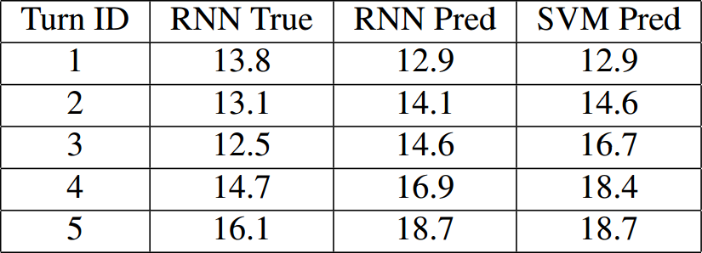
Experiments
The Dataset
1461 natural language query sessions.
Each session consists of 5 turns on average.
9 different domains.
Pre-training
The SENNA embedding obtained from an LM task on Wikipedia.
※ Semantic/syntactic Extraction using a Neural Network Architecture
Per-turn comparison of RNN and SVM (column 3 and 4), as well as using true and predicted label for RNN (column 2 and 3)

Slide 9
conclusion
Proposes the recurrent neural network for contextual domain classification in a multi-turn multi-domain SLU session.
The resulting model outperforms SVM with contextual features by significant margins.

Slide 10
Thank you

